Slide 1
MOOC Learner Behaviors by Country and Culture; an Exploratory Analysis
Zhongxiu “Aurora” Liu, Rebecca Brown, Collin Lynch, Tiffany Barnes, Ryan Baker, Yoav Bergner, Danielle Mcnamara
Z. Liu, et al.
Notes:
Hello. My name is Aurora and I am a 2nd year PhD student from NC State, Researching Game-based Learning. Here i present my work on….<read the title>
The motivation behind this study is how cultural difference translate into learning, and how can we can answer this question with the rich data resulted from e-learning platform
Improve background:
Bottom: edm, liu et al. page

Slide 2

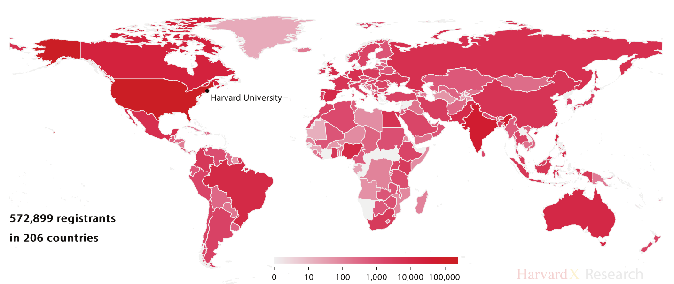

Introduction
How Should E-learning Platforms Respond to Culture?
HarvardX MOOCs Registrants (Nesterko, 2013)
Z. Liu, et al.
Notes:
MOOC is an international e-learning platform. For example, in 2013 Nesterko made this graph to show registrants of HarvardX MOOCs, from around the world. Most MOOC are designed as one path fit all, however, different culture may learn differently. I do computer science outreach in raleigh, and middle school classroom are many times like this. While where I grow up in, middle school classrooms are like this. As mooc and other e-learning platform attract larger and larger audience internationally, how should we respond to culture? This work serve as an initial step or understanding cultural differences in mooc learner behaviors.

Slide 3
Educational Technology Research With Cultural Awareness
Related Work
In the past decade, there has been substantial increase in studying cross-cultural behaviors in e-learning systems
Approach 1: Coding behaviors through field observations (Rodrigo et al., 2013; Ogan et al., 2015)
Approach 2: Data-mining (Ogan et al., 2015; Saarela et al., 2015)
Challenge: Interpretation. why these differences occur? and how to relate to more general cross-cultural variation?
EDM 2016
Z. Liu, et al.
Notes:
Let me provide more context through related work. There has been substantial increase in the study of cross-cultural behaviors in e-learning systems. Common approaches include coding student behaviors through field observations, and data mining. Many prior work has been presented at this conference. The challenge is not on finding the difference, but on interpreting the result: why these differences occur, and how to relate to more general cross-cultural variation.

Slide 4
Massive Open Online Courses (MOOC)
Related Work
Common Research Focuses: Dropout, Engagement
Approach 1: Predicting with machine learning models (Wen&Rose, 2014; Brooks et al., 2015)
Approach 2: Detecting subgroups through clustering students(Kizilcec, 2015; Ferguson, 2015; Anderson, 2014; Bergner, 2015)
Usually use clickstream data to create features such as the freq. of major activities, or ratios between major activities
EDM 2016
Z. Liu, et al.
4
Notes:
Next, i’m going to talk about MOOCs, which popularity is already well-known by this audience. MOOC research has long been focusing on dropout and engagement. One common approach is to predicting from machine learning models. Another, is to detect subgroups through clustering students.
Shouldn’t skip that for the audience (ppl have used cluster primary focus on drop out, we are doing cultural diff)

Slide 5
MOOC
Related Work
Recent focus: understanding learner background
Prior work related demographic and motivational surveys to course completion (Wang&Baker, 2015; Deboer, 2013)
However, few research related geographical information to learner behaviors
(Guo&Reineck, 2014): applied linear regression and found country related to freq of reviewing earlier materials. This work attributed result to teacher/student ratio
(Kizilec et al., 2013): Broke countries into HDI tiers. Found as Human Development Index increases, the proportion of course completers increases
Limitation: These research treated country as an independent factor. No theoretical models to connect results to the impact of culture
EDM 2016
Z. Liu, et al.
Notes:
A recent focus of MOOC research is on understanding learner’s background. Researchers collect demographic informations or psychology attributes relate to goal and motivations through survey, and relate these information back to behaviors.
In regards of demographic information, such as ‘country’, …................... However, these research simply treat country as a independent factor in regression, without delving into behaviors, or explain the impact of culture with theoretical models. Here we consider culture as a higher cluster of differences in demographic, economic and other factors.

Slide 6
Theoretical Frameworks for Cross-cultural Data Analysis
Related Work
Hofstede’s Cultural Dimensions Theory (Hofstede, 2010)
Cultural Dimensions of Learning Framework (CDLF) (Parrish et al.,2010)
Power distance: high-> teacher is of greater authority
Individualism: high ->students speak up more, and value diverse opinions in learning
Masculinity: high-> students like competitions, and have more need for recognition
Uncertainty Avoidance: high -> students focus more on right answers and structured learning
EDM 2016
Z. Liu, et al.
Notes:
From the state of art, there is a need to use theoretical framework to explain and generalize what we may find in data. This bring us to two theoretical frameworks used in prior work and in this study.
The first one is Hofstede. Hofstede collect hundreds of thousands of attitude survey from IBM employees since 1970s, and identified 7 dimensions . Later, Parrish et al. developed CDLF that incorporates Hofstede and some other cultural values , and develop a framework on how these cultural differences manifest in learning. There are four hofstede dimensions incorporated in CDLF.
The first one is power distance. High power distance means means the less powerful people in the society accept the unfairness in power distribution more. The higher...
The next is individualism. High individualism society emphasize more on ‘I’ then ‘We’. .
Masculinity
Uncertainty Avoidance: measures the degree the society accept ambiguous
E.g. U.S. is a country has low power distance and high individualism

Slide 7
In this Work
Analyzed data from 1 MOOC, with 29,149 registrants from 172 countries
Used Hofstede’s Cultural Dimensions, and Cultural Dimensions of Learning Framework (CDLF)
Found clear and explainable inter-cultural differences in learner behaviors
EDM 2016
Z. Liu, et al.
Notes:
Now we understand the problem to solve and the tool we used, its time to introduce my work. In this work, I analyze data from __________. I used _________ to interpret data. And we found interpretable________.

Slide 8
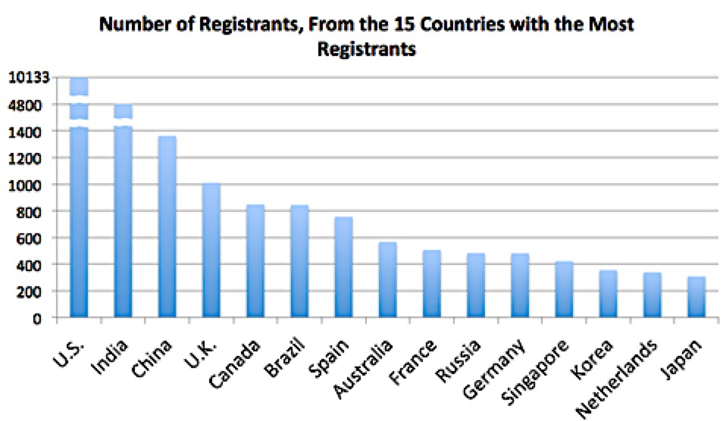
Data
Data
An 8-week long Coursera MOOC – “Big Data in Education”
Video lectures; discussion forum; weekly auto-graded quizzes (multi-choice or numerical input) with 3-5 attempts allowed in two weeks.
Grade: 6 highest/8 quizzes; students can achieve normal/distinction certificates
Clickstream data from 29149 students, 172 countries
User id, url (identify activity), timestamp, ip (identify country)
638 got certifications
750 posted in forum
27558 bystanders
EDM 2016
Z. Liu, et al.
Notes:
Let us start with data. The data is from a 8-week long coursera mooc. The course contain _________. The grade is determined by __________.
The data are in the format of clickstream data, contains ____________, We used ip to determine country. The data is from _____ students __ countries. Here is the top 10 countries with the most registrants. Among these registratns, _____________.
Make it more clear quizzes have multiple attempt to provide more background for later data

Slide 9
Data
Data
From clickstream data, we extracted major activities:
VL: view lectures
AQ, SQ: attempt/submit quizzes
RP, MP: read posts, make posts
Limitation: clickstream data represent the initial access of course activities, no information on time spent on the activities.
EDM 2016
Z. Liu, et al.
Notes:
We extract activities from clickstream data, and organize them using the n-gram approach. The activities we focus here are : VL, AQ, SQ, RP, MP. Note that ….....

Slide 10
Roadmap of Research Questions
Methods & Results
Identify categories of Users
(RQ1: Course Activity Profiles)
Country-wise differences? (RQ2: CAP distr. By Country)
Delve into each CAP’s behavior
Hofstede Cultural Dimensions
Segment activities around Quiz
(RQ3: Quiz Activity Profiles)
Culture-wise Differences?
(RQ4: QAP by Country)
(RQ5: Forum Best Friend)
Activities in Forum
(Brown et al., 2015; Fire et al., 2012)
EDM 2016
Z. Liu, et al.
Notes:
Having understand the data, let’s see a roadmap of research questions. Firstly, we identify categories of users through frequency of course activities, we call this CAP. Next see how CAP distribution differ by country.The reason we did this as the first step, is due to findings in prior work that some countries have higher percentage of course completers than others. It is unfair to compare countries with most competitors, to countries with most people soley view lecture. Without this step, our cultural difference could actually differences among categories of users.
After identify different categories of users, we delve into each CAP’s behaviors. We arrange activities around quizzes, and construct quiz activity profiles. The reason we do this is because MOOC is a lot about self-regulated learning. Some students do work every day. While other only access mooc at the due day of assignment. Instead of a fine-grained time, This segmentation of activities allow us to analyze behaviors on students’ own learning schedule.
Next, we build upon prior work on analyze the activities in forum. Lastly , we see the cultural-wise differences in quiz and forum activities. Notice we moved from country-wise to culture-wise. Thats where the Hofstede cultural dimensions are applied. Hofstede nubmer are… from which we cluster country to culture.

Slide 11
RQ1: Course Activity Profiles (CAPs)
Methods & Results
Q: What are the main categories of students, based on the total and relative frequencies of accessing different course activities?
Method: we hierarchically clustered students on number of lectures viewed and quizzes attempted
EDM 2016
Z. Liu, et al.
Notes:
Just read
Let’s start with RQ1: CAP. The question here is ______. To do this, we used hierarchical cluster on number of lectures viewed and quiz attempted. The purpose of this is to identify a small set of meaningful clusters that can assist answering later research questions.

Slide 12
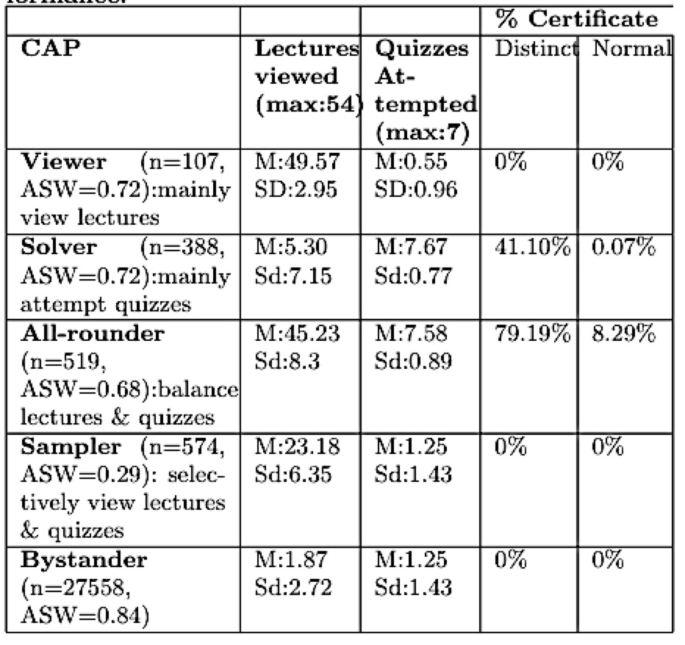
RQ1: Course Activity Profiles (CAPs)
Methods & Results
5 CAPs, closely resembles previous work (Anderson et al., 2014)
All-rounders, who had a balance number of lectures viewed and quizzes attempted had the highest rate of receiving certificate
EDM 2016
Z. Liu, et al.
Notes:
We found ___, which closely resembles prior work. Viewers…., Solvers, .... All-founders is _____________. In the later analysis, I decided to focus on ________, because they have high silhouette values and decent activties.
When put up yellow get rid of black

Slide 13
RQ1: Course Activity Profiles (CAPs)
Methods & Results
5 CAPs, closely resembles previous work (Anderson et al., 2014)
All-rounders, who had a balance number of lectures viewed and quizzes attempted had the highest rate of receiving certificate
In later analysis, we focus on three categories with sufficient activities and good Average Silhouette Value (ASW) (Rousseeuw,1987)
EDM 2016
Z. Liu, et al.
Notes:
We found ___, which closely resembles prior work. Viewers…., Solvers, .... All-founders is _____________. In the later analysis, I decided to focus on ________, because they have high silhouette values and decent activties.
When put up yellow get rid of black

Slide 14
RQ2: CAPs by Country
Methods & Results
Q: Does the proportion of CAP differ by country?
Method: we hierarchically clustered countries based on CAP distribution
EDM 2016
Z. Liu, et al.
Notes:
Next, we look into CAP by country. Does the proprotion of CAP differ by country. We applied hiearchical cluster on countries, based on CAP distribution. We clustered on countries with more then 15 viewer, solver and all-rounder.

Slide 15
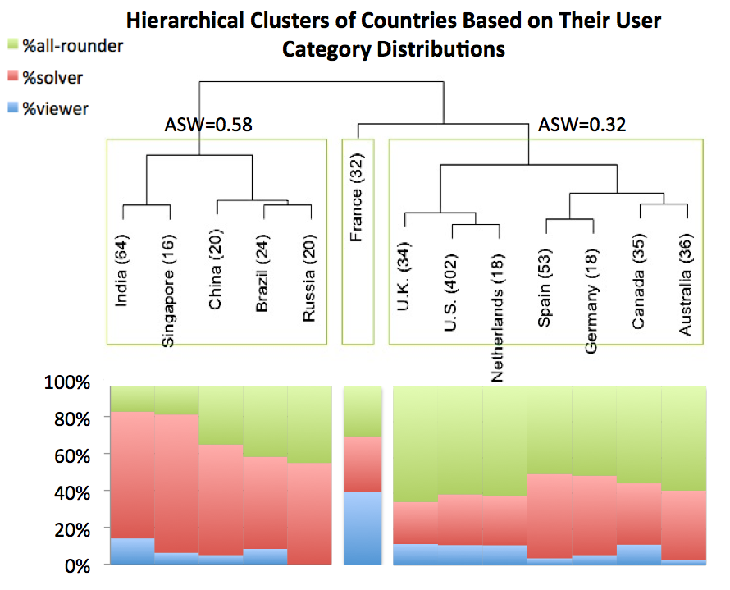
RQ2: CAPs by Country
Methods & Results
Cluster 1: contains all developing countries + Singapore
Cluster 3: contains all developed countries
Proportion of solver in Cluster1 is significantly higher than Cluster 3 (p<0.001)
EDM 2016
Z. Liu, et al.
Notes:
Here is our result. We found cluster 1 …, cluster 3....
Fix france

Slide 16
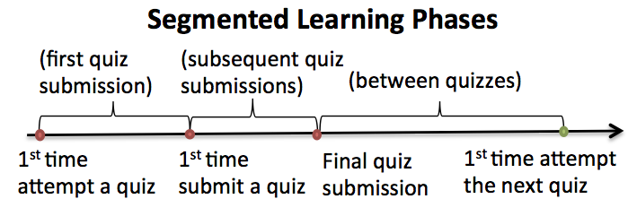
RQ3: Quiz Activity Profiles (QAP)
Methods & Results
Q: When does each category access each type of course activity, relative to quiz submissions?
Method:
We applied the Kruskal-Wallis Test (Northcutt et al., 1952) with Benjamini Hochberg correction (Benjamini&Hochberg, 1995), to compare major activity frequencies.
EDM 2016
Z. Liu, et al.
Notes:
Next, after understanding user categories, we delve into learner behaviors controlled by user category. Instead of segment sequence of activities based on time (week, days) as in preivous work, we segment activities in to the below learning phases. This way, we analyze behavior on student’s own learning schedule. We then calculated frequency of learning activities per phase, and compared it with K….
Notice due to viewers focus soley on viewing lecture, we exclude them from this part of analysis

Slide 17
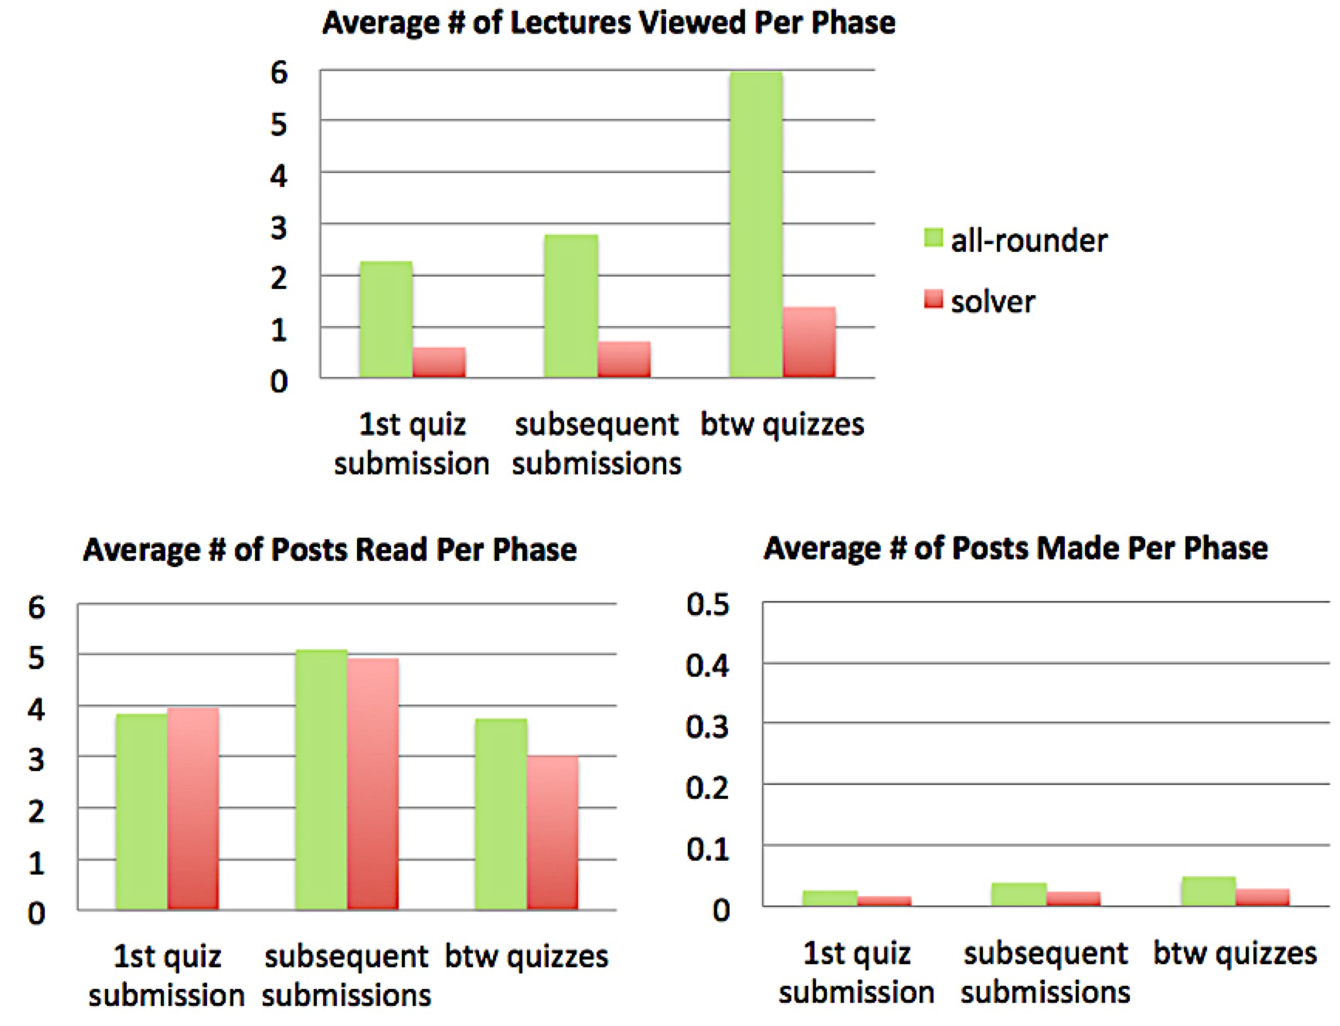
RQ3: Quiz Activity Profiles (QAP)
Methods & Results
Both solvers and all-rounders viewed most lectures between quizzes, and read most posts during subsequent quiz submissions (p<0.01)
EDM 2016
Z. Liu, et al.
Notes:
We found that despirte CAP

Slide 18
RQ4: QAP by Culture
Methods & Results
Q:How do quiz-related profiles relate to culture clusters
Method:
Countries to culture clusters: hierarchically clustered countries on Hofestede’s Cultural Dimension numbers (Hofstede&Hofstede, 2010)
Kruskal-wallis & Benjamini Hochberg Correction
EDM 2016
Z. Liu, et al.
Notes:
Next, we proceed to QAP by culture. We first cluster countries to cultures through hierarhical clustering.
The numbers are measured by…. Hofestede states that the numbers only have meaning when they are compared with other Hofstede numbers.
Fix all grammar

Slide 19
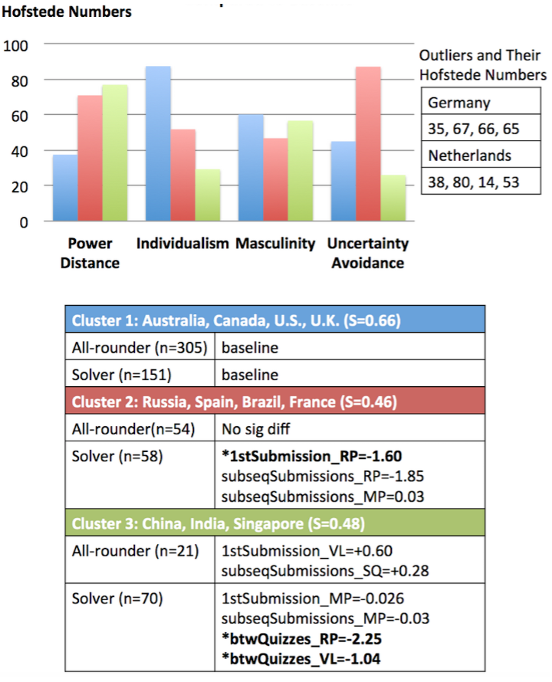
RQ4: QAP by Culture
Methods & Results
Cultural clusters overlap with CAP clusters. Cluster 1 is a subset of all-rounder dominant CAP cluster; Cluster 3 is a subset of solver dominant CAP cluster.
Cluster 2&3: solvers read *significant, or marginally significant fewer posts, during multiple learning phases
Cluster3: solvers viewed less lectures between quizzes; all-rounders viewed more lectures during first quiz attempt, and submitted quizzes more times
EDM 2016
Z. Liu, et al.
Notes:
Here is the result of cultural clusters. The first is ….., which is a group has low pd but high i compared with others. The second , has high UA. the third…, has high pd, and lowest I.
Below each cluster, are number of all-rounder and solvers, and the significant values (in bold and star), and marginal significant values.
We found …
We found…..

Slide 20
RQ5: Forum Best friend
Methods & Results
Q: Is a student’s most frequent forum partner in the same country/culture?
Method: “best friend” in forum interaction (Brown et al., 2015; Fire et al., 2012)
We applied chi-squared test: groups (in/out a cultural cluster or country)
categories (forum best friend in/out the cultural cluster or country)
U.S., cluster 1
China, cluster 3
Canada, cluster 1
Forum Community Example
Z. Liu, et al.
Notes:
Lastly. The questions. After look into quizzes, we look into forum. The method, we find best friend through brown, lynch and barnes previous work. For example, … high weigh represent more communications or interactions between these students post. So .... Are best friends. We than use chi-square to . the purpose is to find whether a country/culture has significantly more best firned in/outside its own country/culture.

Slide 21
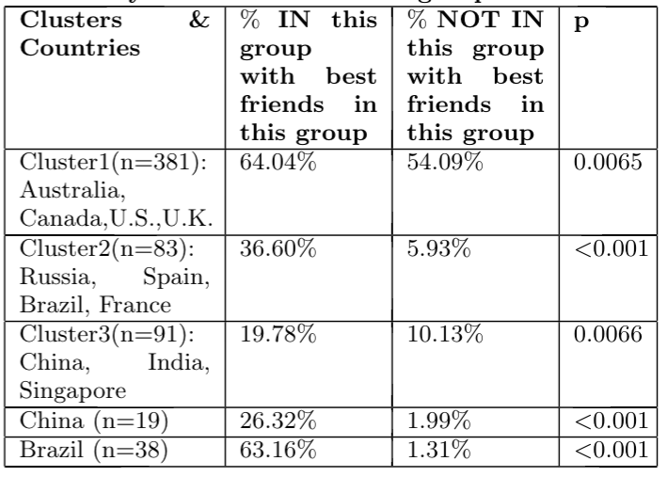
RQ5: Forum Best friend
Methods & Results
For all Culture Clusters, students are significantly more likely to have best friend from the same culture
China and Brazil are significantly more likely to have best friends in their own countries
Z. Liu, et al.

Slide 22
Discussion
Discussion
What did we learn?: Student behaviors in MOOC despite cultural influence.
Identify categories of Users
(RQ1: Course Activity Profiles)
Country-wise differences? (RQ2: CAP distr. By Country)
Delve into each CAP’s behavior
Hofstede Cultural Dimensions
Segment activities around Quiz
(RQ3: Quiz Activity Profiles)
Culture-wise Differences?
(RQ4: QAP by Country)
(RQ5: Forum Best Friend)
Activities in Forum
(Brown et al., 2015; Fire et al., 2012)
Z. Liu, et al.
Notes:
Now we get the result. What do the results mean. Here’s the roadmap of research questions again. Let’s first focus on interpreting the results from RQ1 and RQ3: what we learn from students behaviors in mooc, despite the culture differences.

Slide 23
Students behaved in this MOOC despite Culture influence.
Discussion
RQ1: Course Activity Profiles
We found similar CAPs as in prior work. A balanced ratio of lectures viewing and quiz attempts is a good indicator of students who are working towards a certificate.
RQ3: Quiz Activity Profiles
Regardless of CAPs, students viewed most lectures between quizzes and most forum posts during the subsequent quiz attempts. This resembles activities in traditional classroom setting.
Z. Liu, et al.
Notes:
First, from Course Activity Profiles, we found…. From quizz attemp and lectures viewed. Because all0rounders..., we conclude that...
From RQ4: we segmented activities based on .... And calcualated their frequeneis. We found

Slide 24
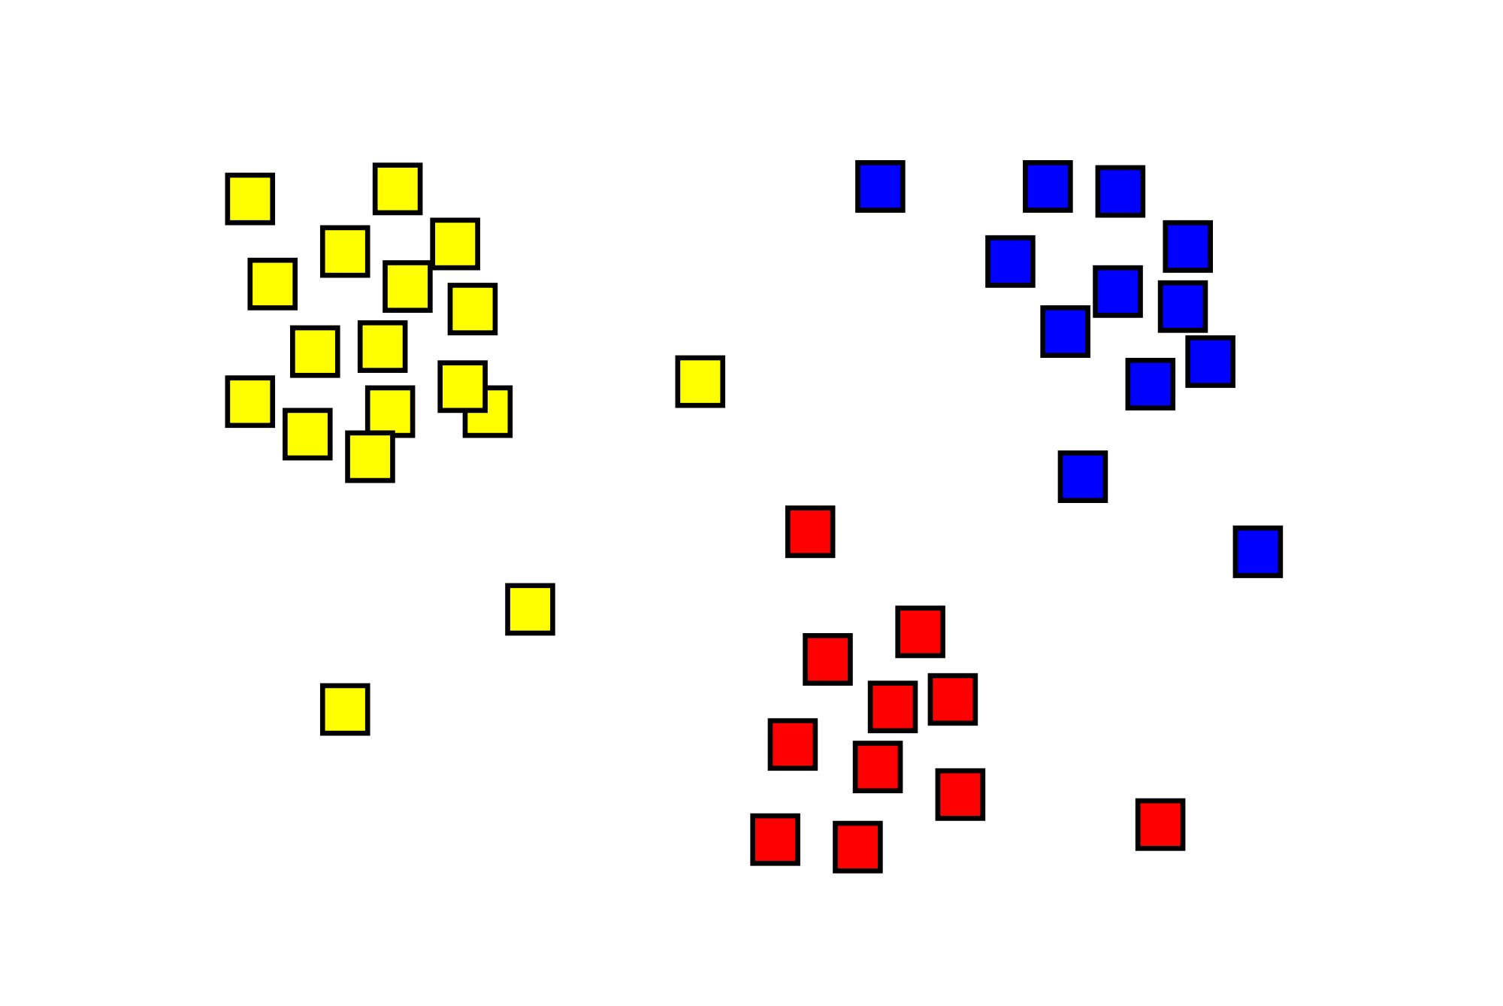
Discussion
Discussion
What did we learn?: CAP and Culture Clusters.
Identify categories of Users
(RQ1: Course Activity Profiles)
Country-wise differences? (RQ2: CAP distr. By Country)
Delve into each CAP’s behavior
Hofstede Cultural Dimensions
Segment activities around Quiz
(RQ3: Quiz Activity Profiles)
Culture-wise Differences?
(RQ4: QAP by Country)
(RQ5: Forum Best Friend)
Activities in Forum
(Brown et al., 2015; Fire et al., 2012)
EDM 2016
Z. Liu, et al.
Notes:
Next, we derived clusters of countries based on CAP and hofstede dimensions. Let’s see what these two clusters tell us.

Slide 25
Country Clusters by CAP and by Culture.
Discussion
RQ2: Country Clusters by CAP
We found cluster 1 has higher percentage of solver. These countries (mostly developing countries) may study off-line, or use MOOC as a certificate system for career advancement
RQ2 and Cultural Clusters
Culture cluster (India, Singapore, China) is a subset of solver-dominant cluster. This high % of solver may due to Asian’s exam-centric education. (Leung, 2011; Wong, 2004)
Solver Dominant: China, India, Singapore
Russia, Brazil,
All-rounder Dominant
U.S., U.K., Netherlands, Spain, Germany, Australia, Canada,
China, India, Singapore
Russia, Spain, Brazil, France
U.S. Australia, Canada, U.K.
EDM 2016
Z. Liu, et al.
Notes:
RQ2, we found…... This may because ......
Moreover, we found overlap, so
Animation is wrong here

Slide 26
Discussion
Discussion
Identify categories of Users
(RQ1: Course Activity Profiles)
Country-wise differences? (RQ2: CAP distr. By Country)
Delve into each CAP’s behavior
Hofstede Cultural Dimensions
Segment activities around Quiz
(RQ3: Quiz Activity Profiles)
Culture-wise Differences?
(RQ4: QAP by Country)
(RQ5: Forum Best Friend)
Activities in Forum
(Brown et al., 2015; Fire et al., 2012)
Culture-wise differences in major activities
EDM 2016
Z. Liu, et al.
Notes:
Next, lets move to the next part, what is the cultural wise differences

Slide 27
Activity Frequencies in QAP
Discussion
RQ4: QAP distr. by Country
For solver: cluster 1&2 with lower individualism and higher power distance compared to cluster 3, read less forum posts between and during quizzes
Explainable by CDLF: teachers in clusters 1&2 are treated with higher authority, while diverse opinions in learning are valued less.
For solver: cluster 1 viewed less lectures between quizzes
For all-rounder: cluster 1 viewed more lectures during the first quiz submission and submit quizzes more times
Not explainable by CDLF. Explainable by the exam-centric educational culture in Asia. . (Leung, 2011; Wong, 2004). Students arranged more activities around quizzes, and focused more on getting the quizzes correct.
China, India, Singapore
Russia, Spain, Brazil, France
U.S. Australia, Canada, U.K.
EDM 2016
Z. Liu, et al.
Notes:
We found

Slide 28
Forum Interactions
Discussion
RQ5: Forum Best Friend
Students had significantly more ‘best friends’ within their own culture clusters, and within China and Brazil
Students from different cultures view the role of shared discussion differently (CDLF)
Language barriers
Students from the some country know each other outside this MOOC
EDM 2016
Z. Liu, et al.
Notes:
Lastly, forum best friend. We found

Slide 29
Discussion
Discussion
Identify categories of Users
(RQ1: Course Activity Profiles)
Country-wise differences? (RQ2: CAP distr. By Country)
Delve into each CAP’s behavior
Hofstede Cultural Dimensions
The Big Picture
Segment activities around Quiz
(RQ3: Quiz Activity Profiles)
Culture-wise Differences?
(RQ4: QAP by Country)
(RQ5: Forum Best Friend)
Activities in Forum
(Brown et al., 2015; Fire et al., 2012)
EDM 2016
Z. Liu, et al.
Notes:
After we interpret result from each individual parts, lets see the big picture

Slide 30
Discussion
Discussion
Different cultures and countries exhibited different learning behaviors, explainable by CDLF and educational culture.
In general, learner behaviors are related to the importance of learning activities within learners’ country and culture
EDM 2016
Z. Liu, et al.
Notes:
In general, we found…......
We conclude that

Slide 31
Contribution & Future Work
Conclusion & Future Work
Contribution: This study increased the understanding of different behaviors within MOOC population, and how these differences related to cultural and educational differences.
Addressed important research issues in e-learning
Combined results with theoretical framework
Proposed novel analyses
Future Work
Generalizability of findings: we can easily apply this methods to other e-learning platforms, but will the same results stand?
Design Implications: need more studies to find out: should MOOC designers intervene? One MOOC for all, or cultural-tailored track?
EDM 2016
Z. Liu, et al.
Notes:
Finally, we reached conclusion.
Probably no time to present this
While this study found explainble differences, we need more work to turn these findings into actions.
Add’ is culture more important, or course activity profiles”? I presented many ways of slicing and analyzing students
“Stop using the word culture”. Don’t make broad claim that piss people off.

Slide 32
Citations
A. Anderson, D. Huttenlocher, J. Kleinberg, and J. Leskovec. Engaging with massive online courses. In the 23rd ACM Int. conf. on World Wide Web, pages687-698, 2015
Y. Benjamini and Y. Hochberg. Controlling the false discovery rate: a practical and powerful approach to multiple testing. Journal of the Royal Statistical Society. Series B (Methodological), 289-300, 1995.
Y. Bergner, D. Kerr, and D. E. Pritchard. Methodological challenges in the analysis of MOOC data for exploring the relationship between discussion forum views and learning outcomes. In The 8th Int. conf. on Educational Data Mining, 2015.
C. Brooks, C. Thompson, and S. Teasley. A time series interaction analysis method for building predictive models of learners using log data. In the Fifth Int. conf. on Learning Analytics And Knowledge, pages 126-135, 2015.
R. Brown, C. Lynch, Y. Wang, M. Eagle, J. Albert, T. Barnes, R. Baker, Y. Bergner, and D. McNamara. Communities of performance & communities of preference. In the 2nd Int. Workshop on Graph-Based Educational Data Mining, 2015.
J. DeBoer, G. S. Stump, D. Seaton, and L. Breslow. Diversity in MOOC students' backgrounds and behaviors in relationship to performance in 6.002 x. In the Sixth Learning Int. Networks Consortium conf.,2013.
R. Ferguson and D. Clow. Examining engagement: analysing learner subpopulations in massive open online courses (MOOCs). In the Fifth Int. conf. on Learning Analytics And Knowledge ACM, pages 51-58, 2015.
M. Fire, G. Katz, Y. Elovici, B. Shapira, and L. Rokach. Predicting student exam's scores by analyzing social network data. In the 7th Int. Workshop on Active Media Technology, 2012.
P. J. Guo and K. Reinecke. Demographic differences in how students navigate through MOOCs. pages 21-30, 2014.
EDM 2016
Z. Liu, et al.

Slide 33
Citations
G. Hofstede and G. J. Hofstede. Cultures and organizations: Software of the mind (3rd ed.). McGraw-Hill, New York, USA, 2010
R. F. Kizilcec, C. Piech, and E. Schneider. Deconstructing disengagement: Analyzing learner subpopulations in massive open online courses. In the 3rd Int. conf. on learning analytics and knowledge, pages 170-179, 2013.
F. K. Leung. In search of an East Asian identity in mathematics education. Educational Studies in Mathematics, 17(1), 35-51, 2001
S. Nesterko, D. Seaton, J. Reich, and I. Chuang. Evaluating Geographic Data in MOOCs. NIPS Workshop on Data Driven Education (pp. 1–7). 2013.
C. G. Northcutt, A. D. Ho, and I. L. Chuang. Use of ranks in one-criterion variance analysis. Journal of the American statistical Assoc., 47(260):583-621, 1952.
A. Ogan, B. R. Walker, E., M. M. T. Rodrigo, J. C. Soriano, and M. J. Castro. Towards understanding how to assess help-seeking behavior across cultures. Int. Journal of Artificial Intelligence in Education, 25(2):229-248, 2015.
A. Ogan, E. Yarzebinski, P. Fernandez, and I. Casas. Cognitive tutor use in Chile: Understanding classroom and lab culture. In the 17th Int. conf. on Artificial Intelligence in Education, pages 318-327, 2015.
P. Parrish and J. Linder-VanBerschot. Cultural dimensions of learning: Addressing the challenges of multicultural instruction. The Int. Review of Research in Open and Distributed Learning, 11(2), 2010.
M. M. T. Rodrigo, R. S. J. D. Baker, and L. Rossi. Student off-task behavior in computer-based learning in the Philippines: comparison to prior research in the usa. Teachers College Record, 115(10):1-27, 2013.
P. J. Rousseeuw. Silhouettes: a graphical aid to the interpretation and validation of cluster analysis. Journal of computational and applied mathematics, 20:53-65, 1987.
EDM 2016
Z. Liu, et al.

Slide 34
Citations
M. Saarela and T. Karkkainen. Do country stereotypes exist in PISA? a clustering approach for large, sparse, and weighted data. In the 8th Int. conf. on Educational Data Mining, 2015.
Y. Wang and R. Baker. Content or platform: Why do students complete MOOCs? MERLOT Journal of Online Learning and Teaching, 11(1), 17-30, 2015.
M. Wen and C. P. Ros e. Identifying latent study habits by mining learner behavior patterns in massive open online courses. In the 23rd ACM Int. conf. on Information and Knowledge Management, pages 1983-1986, 2014.
J. K. K. Wong. Are the learning styles of Asian int. students culturally or contextually based? Int. Education Journal, 4(4), 154-166, 2004.
M. Zhu, Y. Bergner, Y. Zhang, R. Baker, E. Wang, and L. Paquette. Longitudinal engagement, performance, and social connectivity: a MOOC case study using exponential random graph models. In The 6th Int. conf. on Learning Analytics and Knowledge, 2016
EDM 2016
Z. Liu, et al.

Slide 35


Thank you!
last page!
EDM 2016
Z. Liu, et al.

